Slide 1
Java programming #1.2 Syntax

Slide 2
Static typization
Types:
Primitives
byte, short, int, long
char
float, double,
boolean
Objects
Arrays

Slide 3
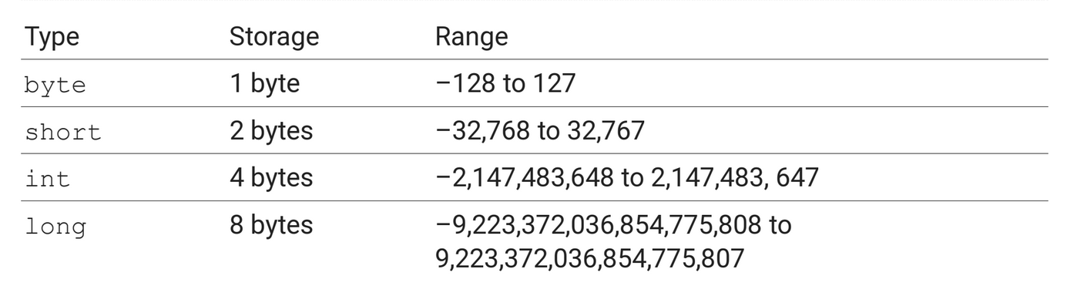
Primitive types

Slide 4
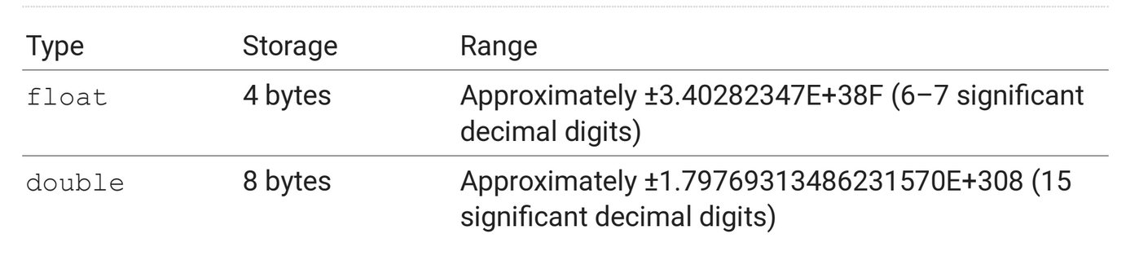
Primitive types

Slide 5
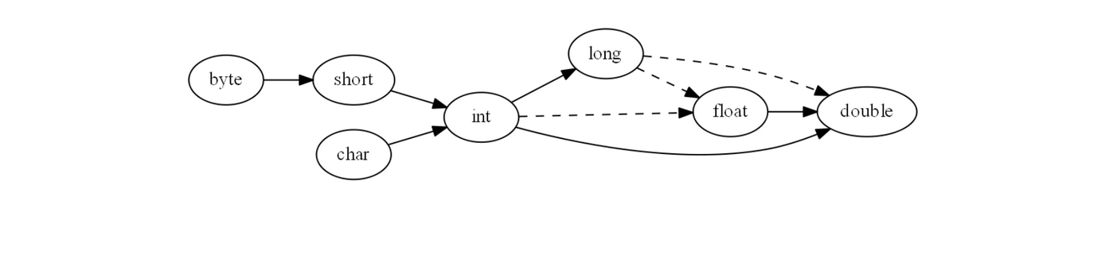
Types relationships

Slide 6
Char
16 bit
UTF-16 encoding

Slide 7
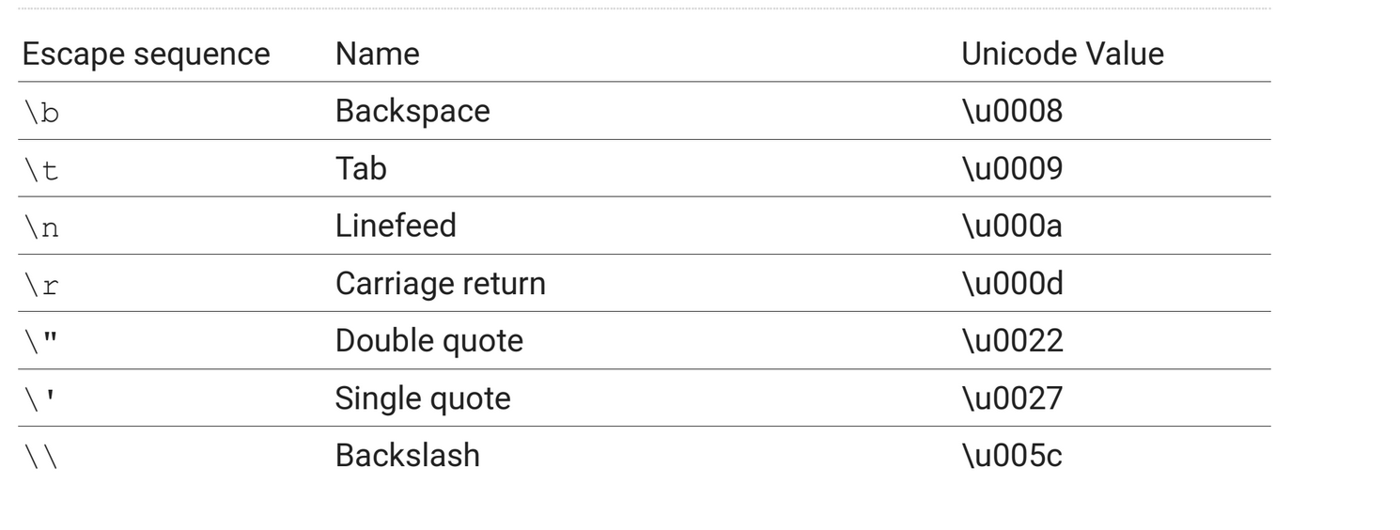
Char literals

Slide 8
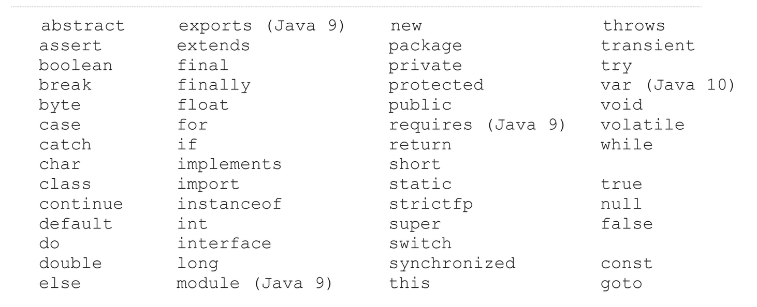
Keywords

Slide 9
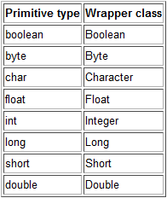
Unboxing / Autoboxing
Oracle Tutorial

Slide 10
Input and output
Input
Scanner
BufferedReader
Output
print / println
printf

